Slide 1

SecureBank
Mobile Cheque Deposit Initiative
SecureBank
Group 6
Pramila Poudel, Amisha Shrestha, Prabesh Rai

Slide 2
AGENDA
1
INTRODUCTION
5
RISK ASSESSMENT & MITIGATION
2
PROBLEM STATEMENT
6
FINANCIAL ANALYSIS
3
PROJECT OVERVIEW
7
STAKEHOLDER ENGAGEMENT STRATEGY
4
BENEFITS
8
CONCLUSION & FINAL RECOMMENDATION

Slide 3


INTRODUCTION
Company Legacy & Evolution
50+ years of banking excellence with a strong regional presence.
Commitment to innovation and customer-centric digital transformation.
55% of customers actively use digital banking, with demand increasing
Market Trends Driving Digital Innovation
Growing customer preference for mobile banking (60% prefer mobile solutions).
Competitive landscape demands digital-first banking experiences.
Regulatory and security enhancements require modernization.

Slide 4

PROBLEM STATEMENT
SecureBank’s outdated manual check deposit process is driving high operational costs, exposing the institution to security and compliance risks, and diminishing customer satisfaction, all while lagging behind competitors in digital innovation demanding an agile, secure mobile solution to transform operations and enhance the overall banking experience.

Slide 5

PROJECT OVERVIEW
Secure Bank is implementing mobile check deposit feature as a part of Digital Transformation Project to enhance customer satisfaction, improve operational efficiency, and maintain a competitive edge.
STRATEGIC FIT : The feature enhances SecureBank’s digital banking ecosystem by integrating seamlessly with current mobile services, supporting our $20M digital transformation strategy.
Impacted Business Processes
Manual check handling and data entry
In-branch customer service workflows
Fraud detection and compliance review
IT and operations coordination
Cost Efficiencies
Reduced paper-based processing and labor costs
20% branch workload reduction (targeted)
Minimized compliance and error-related penalties
Lower physical infrastructure requirements for check storage

Slide 6

WHY ?
Industry Trend
Early adopters of eDeposit gained market leadership
Competitive Risk
Delayed adoption leads to customer loss and reduced relevance.
Market Expectation
Digital banking is now a standard, not a luxury.
Strategic Need
Secure Bank must implement mobile cheque deposit to stay competitive and retain customers.

Slide 7
HISTORY OF E-DEPOSIT IN CANADA
Introduction of Mobile Deposit Services
March 21 – Central 1 launched Deposit Anywhere: to deposit cheques via smartphone
April 17 – Westminster Savings Credit Union (British Columbia) became the first Canadian financial institution to offer mobile cheque deposit to its members.
November 27 – CIBC became the first major Canadian bank to provide e-Deposit to personal and small business customers.
Canadian Bills of Exchange Act and the Canadian Payments Act were amended to define the 'official image' of an eligible bill
May 19: RBC introduced photo cheque deposit functionality to its mobile app.
2012
2014
2007
2013
2015
Canadian Payments Association (CPA) initiated the Image Rule Project to phase in the acceptance of cheque images as alternatives to paper cheques.
Expansion Among Major Banks
July 29: CIBC announced that clients had deposited over one million cheques using eDeposit. ​
October 16: TD Bank launched its Mobile Deposit service.
De Souza, K. (n.d.). History of eDeposit in Canada. Retrieved from https://karenadesouza.com/history-of-edeposit-in-canada/

Slide 8
ANALYSIS OF OPTIONS
Do Nothing
Option 1
Implement Third-Party Solution
Option 2
In-House Development (Recommended)
Option 3
Risk of losing customers to competitors
High operational costs continue
Faster implementation but higher long-term costs
Tailored solution, cost-effective in the long run

Slide 9
MOBILE CHEQUE DEPOSIT FEATURE
01
Auto-Validation of Check Details Automatically scans and validates check amount, date, and signature before submission.
02
Smart Deposit Limits Dynamically adjusts daily/monthly limits based on customer profile and transaction history.
03
Deposit History & Tracking Allows users to view check images and real-time status updates within the app.
04
Multi-Language Support Supports multiple languages to cater to a diverse customer base.
05
AI-Powered Error Detection Detects blurry images or incomplete submissions before processing
06
Push Notifications Instantly notifies customers of deposit status (submitted, approved, or rejected).

Slide 10
PROJECT SCHEDULE
MILESTONES
PHASE IV : Full Rollout & Optimization (Dec 2025 – Jan 2026) Enterprise-wide deployment with performance tracking and continuous improvements.
Business Case Approval – May 2025
PHASE III : Pilot Launch (Nov 2025) Limited rollout to selected customer segments; monitor adoption and gather feedback.
MVP Development Start – July 2025
Internal UAT Completed – September 2025
Pilot Go-Live – November 2025
PHASE II : Development & Testing (Jul – Oct 2025)
Feature build, system integration, and QA/UAT.
Full Launch – January 2026
PHASE I: Initiation & Planning (May – Jun 2025)
Project scoping, stakeholder alignment,
and requirement gathering.
MAJOR DELIVERABLES
Mobile Check Deposit Feature within SecureBank App
Integration with Core Banking & Risk Systems
End-User Training Materials
Cybersecurity Protocols and Fraud Detection Engine
Stakeholder Communication Plan

Slide 11
CORE TEAM MEMBERS
TEAM MEMBERS KEY ROLES
PROJECT MANAGER | Leads execution, manages scope, and ensures timely delivery.
BUSINESS ANALYST | Gathers and refines requirements, bridging business and tech teams.
SOFTWARE DEVELOPERS | Build, test, and integrate the mobile check deposit feature.
ENTERPRISE ARCHITECT | Ensures seamless integration with SecureBank’s legacy systems.
INFORMATION SECURITY LEAD | Oversees cybersecurity, fraud prevention, and compliance.
MARKETING LEAD | Develops customer engagement, adoption, and onboarding strategies.
BRANCH OPERATIONS REP | Coordinates branch workflow adjustments and staff training.
QUALITY ASSURANCE | Identify testable aspects and ensure completeness of requirements.

Slide 12
BENEFITS ANALYSIS
Tangible Benefits (Measurable & Operational)
Intangible Benefits (Strategic & Experiential)
Faster Processing & Automation:
Average processing time improved (Target: 2 hrs | Actual: 1.8 hrs)
Improved Customer Convenience:
24/7 check deposits enhance user satisfaction and accessibility
Cost Savings:
$950K savings on paper-based processing (Target: $1M)
Brand Trust & Loyalty:
Positive experience boosts Net Promoter Score and retention
Increased Revenue:
Boost in digital banking revenue (Target: $5M | Actual: $4.8M)
Innovation & Competitive Advantage:
Positions SecureBank as a tech-forward leader in digital banking
Reduced Branch Workload:
Lower in-person traffic, freeing up staff (Target: 20% reduction | Actual: 18%)
Employee Empowerment:
Frees staff from manual tasks to focus on high-value services
Promotes cross-functional collaboration and morale
Enhanced Security & Compliance:
Fraud detection systems implemented
Improved regulatory compliance (Target: 100% | Actual: 95%)

Slide 13
RISK ASSESSMENT & MITIGATION
Risks | Likelihood | Impact | Mitigation Strategy
Cyberattacks or Data Breaches | Low | High | Advanced cybersecurity measures, continuous monitoring, and incident response planning.
Regulatory Non-Compliance (PIPEDA Standards) | Low | High | Regular compliance audits, legal counsel engagement, and updated staff training.
Failure of Image Recognition Algorithms | High | Medium | Rigorous algorithm testing, iterative improvements, and fallback manual verification.
Slow Customer Adoption | Medium | Medium | Targeted marketing, customer training, monitoring adoption rates, and iterative feature improvements.
Scope Creep & Cost Overruns | Low | Medium | Strict scope management, contingency budgets, and regular financial reviews.

Slide 14
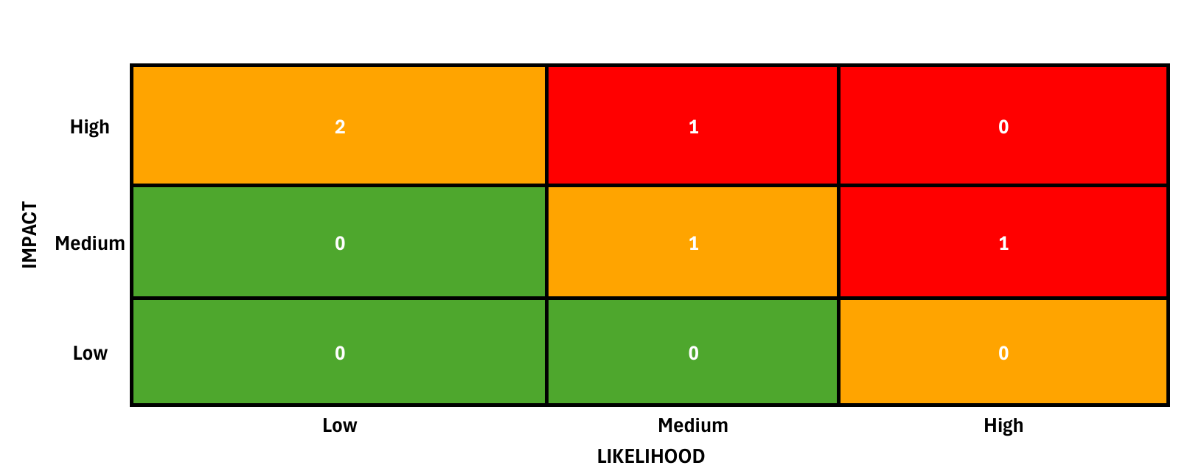
STAKEHOLDER RISKS HEATMAP

Slide 15

💰FINANCIAL ANALYSIS
📈ROI
Positive ROI expected within 2–3 years
Aligns with SecureBank’s $20M digital transformation goals
Supports $500M revenue impact potential through improved digital banking services
💸PROJECT COSTS
One-time implementation cost: $5M
Key Areas: Technology development, security integration, marketing, staff training
📈FINANCIAL BENEFITS
Annual operational cost savings (reduced manual processing, branch workload)
Digital revenue/year from increased digital adoption
Faster funds availability improves cash flow, customer satisfaction, and retention
Improved compliance reduces potential regulatory penalties

Slide 16
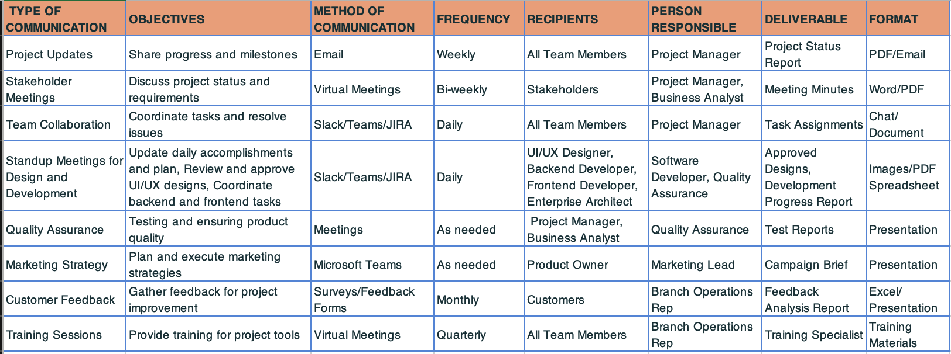
STAKEHOLDER ENGAGEMENT STRATEGY

Slide 17
CONCLUSION & Final Recommendation
SecureBank must modernize its check deposit process to enhance efficiency, improve customer satisfaction, and stay competitive in the digital banking space. Current manual processes lead to high operational costs, security risks, and a suboptimal customer experience.
The Mobile Check Deposit feature directly addresses these challenges by:
Reducing branch workload and processing costs
Improving security through fraud detection and automation
Enhancing customer experience with faster, more convenient deposits
Supporting SecureBank’s broader digital transformation goals
Cost Savings by reducing operational expenses and fraud risks
Revenue Growth through increased digital banking adoption and customer retention
Final Recommendations
Final approval from key stakeholders
Pilot testing in select regions
Full-scale implementation with continuous monitoring
Marketing and customer onboarding initiatives

Slide 18

Thank You !!!
SecureBank

